Slide 1
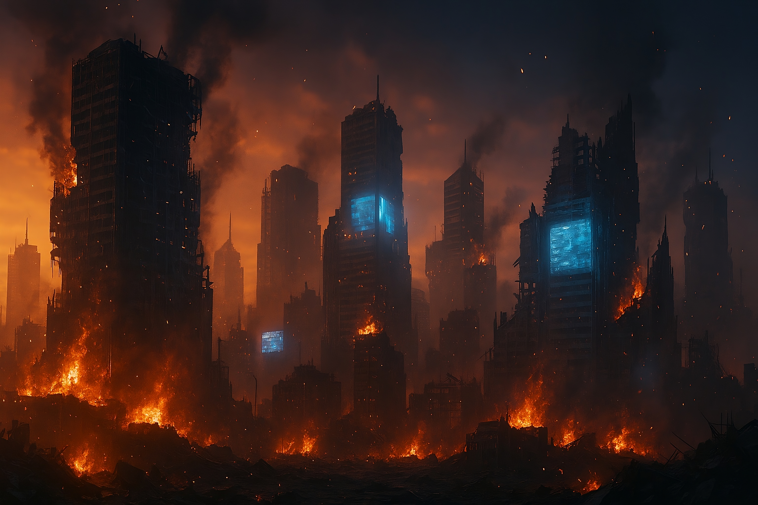
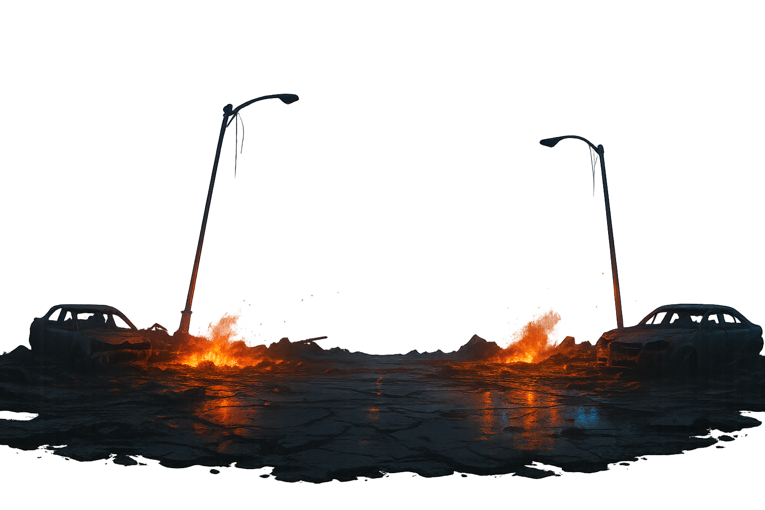


AI RACE
Open this file in the PowerPoint Desktop App in the fullscreen mode. The slides advance automatically — no need to click. If you don’t hear audio, check your device’s sound.

Slide 2
AI RACE

Slide 3
AI RACE
…and the Erosion of Environmental Politics

Slide 4




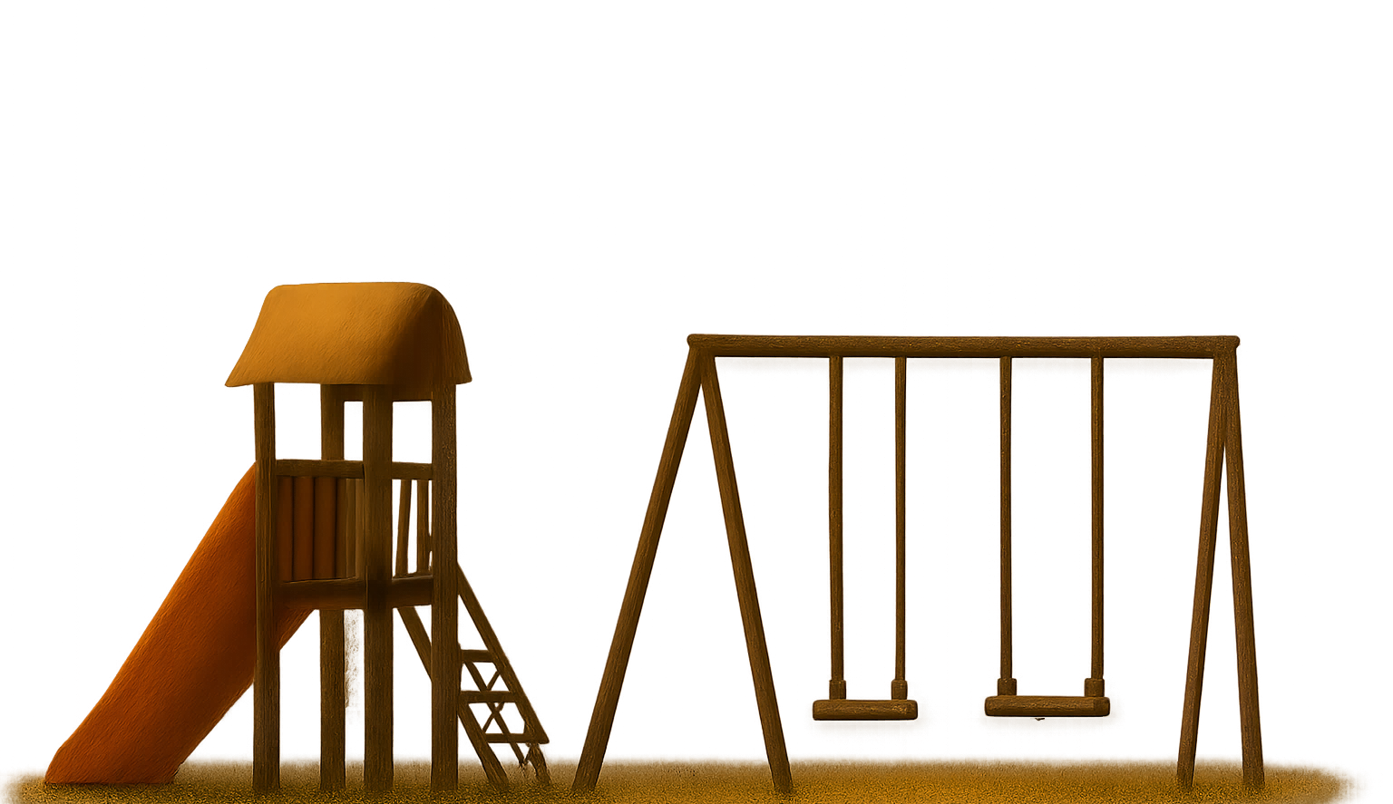
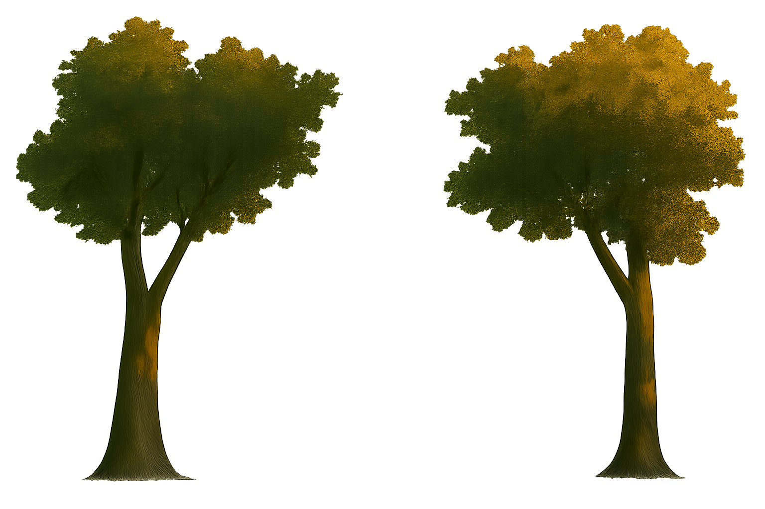




Slide 7
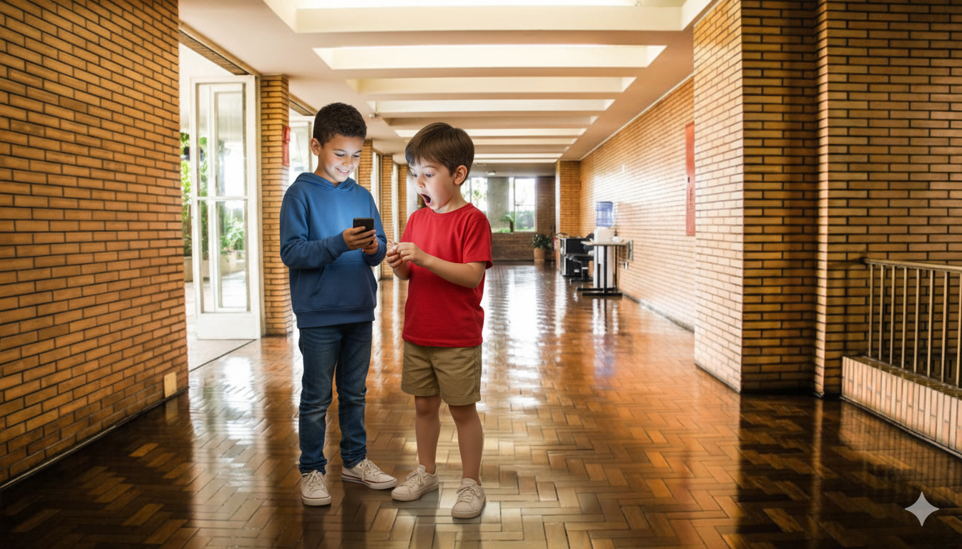

Slide 8



Slide 9
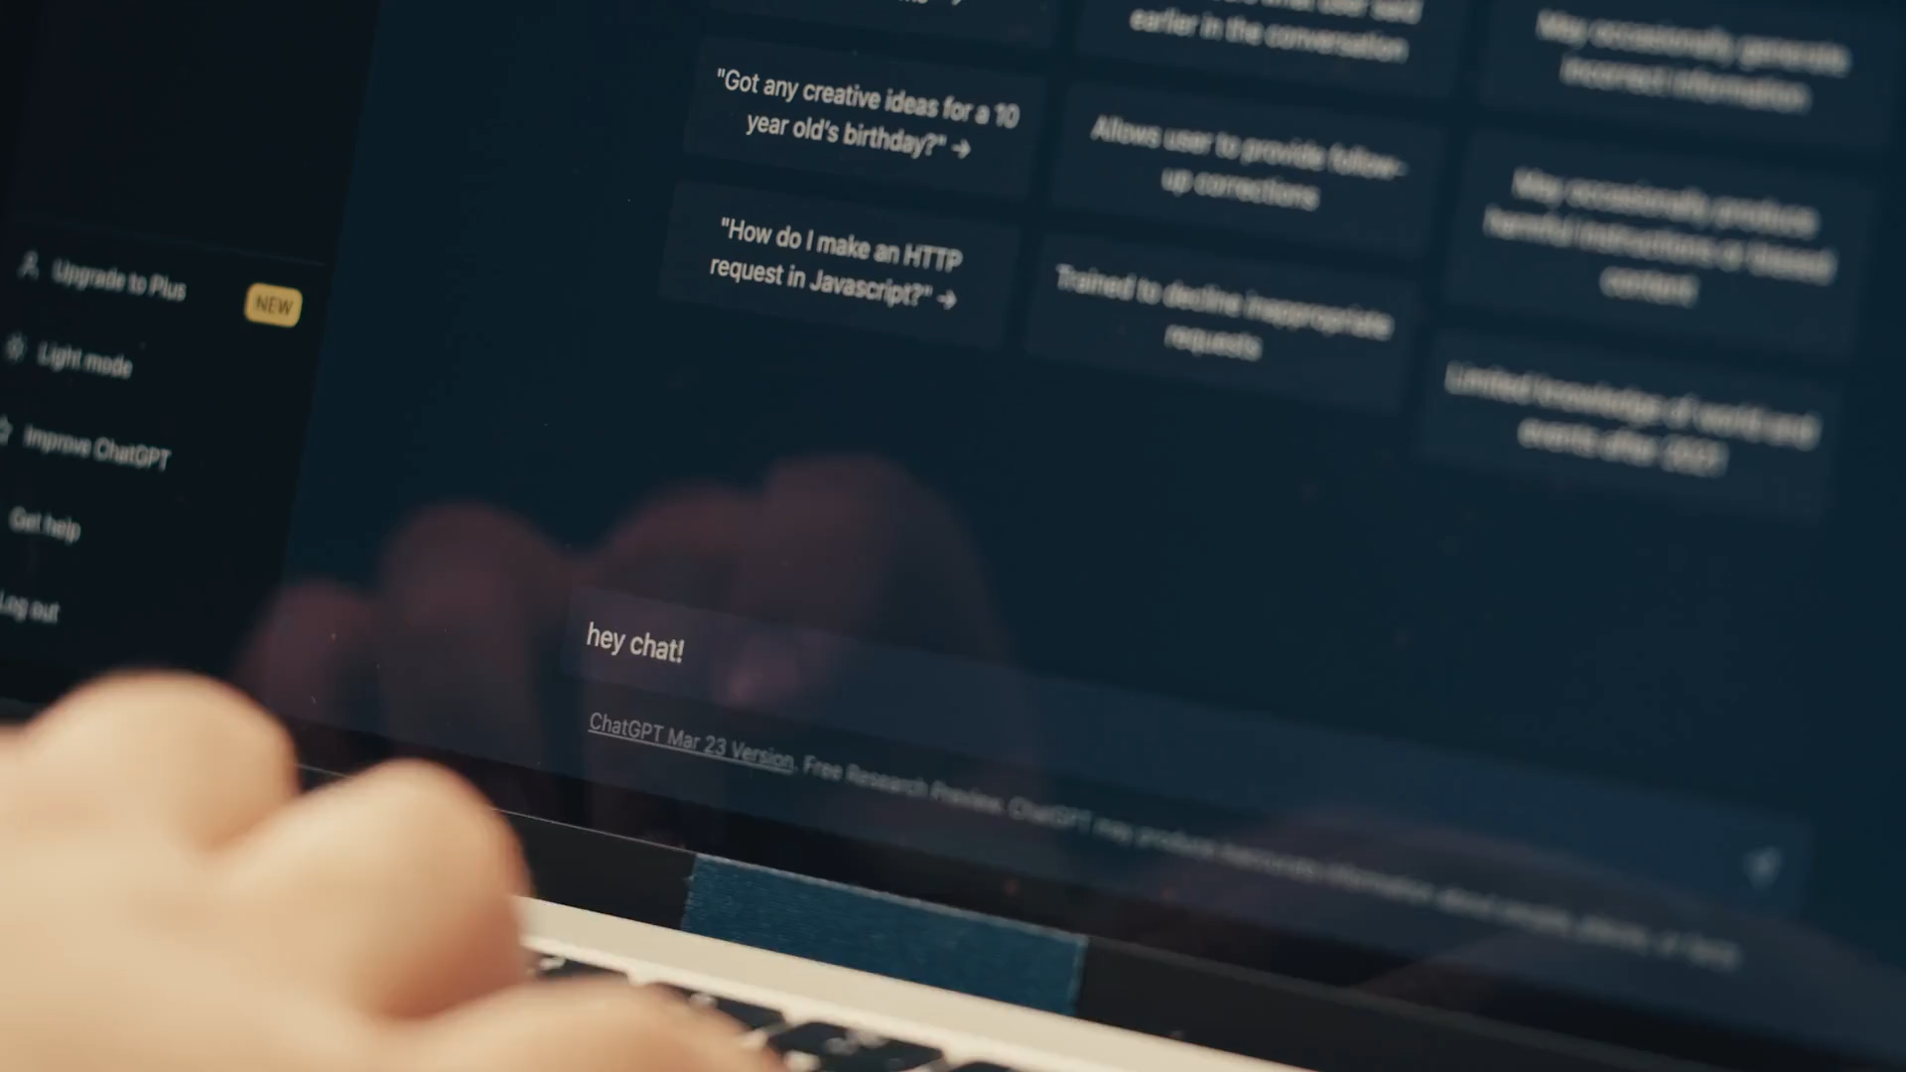

Slide 10




Slide 11


Slide 14
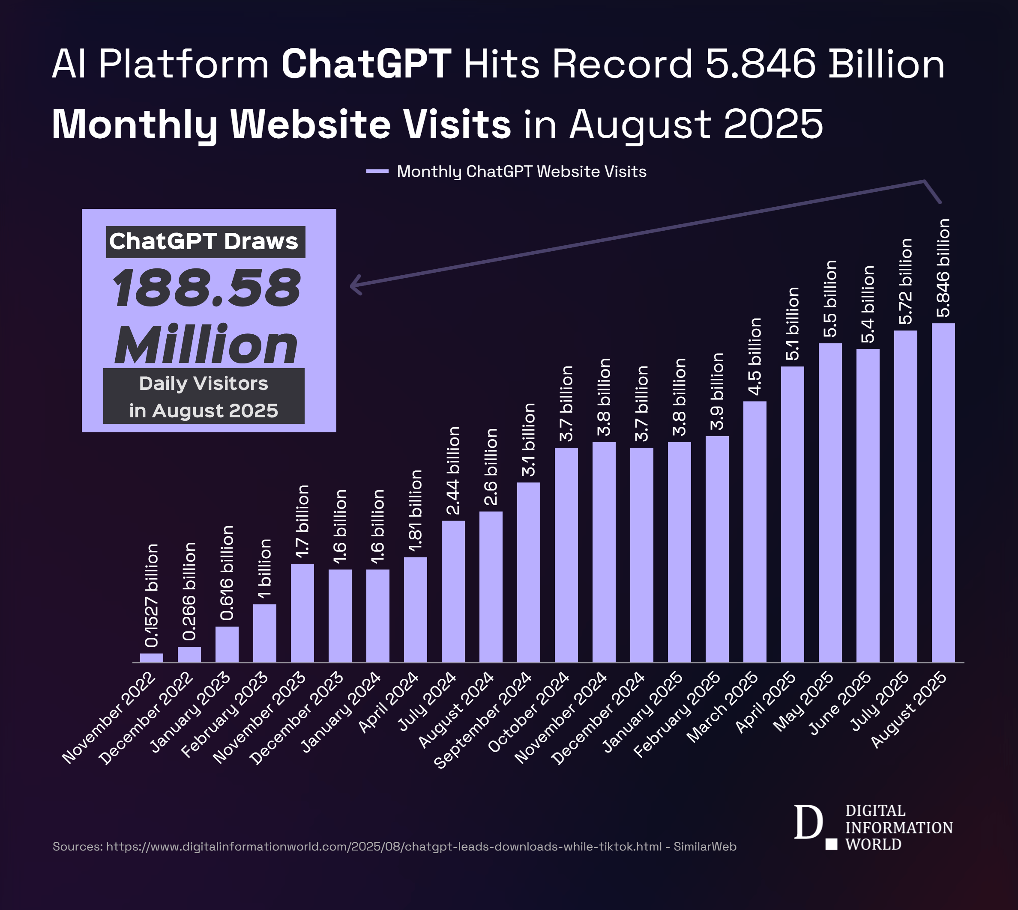
Platform | Year of Launch | Time To Reach 1 Million Users
Instagram Threads | 2023 | 1 hour
ChatGPT | 2022 | 5 days
Instagram. | 2010 | 2 months
Spotify | 2008 | 5 months
Dropbox | 2008 | 7 months
Facebook | 2004 | 10 months
FourSquare | 2009 | 13 months
Twitter | 2006 | 2 years
Airbnb | 2008 | 2.5 years
Kickstarter | 2009 | 2.5 years
Netflix | 1999 | 3.5 years

Slide 15
Platform | Year of Launch | Time To Reach 1 Million Users
Instagram Threads | 2023 | 1 hour
ChatGPT | 2022 | 5 days
Instagram. | 2010 | 2 months
Spotify | 2008 | 5 months
Dropbox | 2008 | 7 months
Facebook | 2004 | 10 months
FourSquare | 2009 | 13 months
Twitter | 2006 | 2 years
Airbnb | 2008 | 2.5 years
Kickstarter | 2009 | 2.5 years
Netflix | 1999 | 3.5 years

Slide 16
Platform | Year of Launch | Time To Reach 1 Million Users
Instagram Threads | 2023 | 1 hour
ChatGPT | 2022 | 5 days
Instagram. | 2010 | 2 months
Spotify | 2008 | 5 months
Dropbox | 2008 | 7 months
Facebook | 2004 | 10 months
FourSquare | 2009 | 13 months
Twitter | 2006 | 2 years
Airbnb | 2008 | 2.5 years
Kickstarter | 2009 | 2.5 years
Netflix | 1999 | 3.5 years

Slide 17
100 million

Slide 18
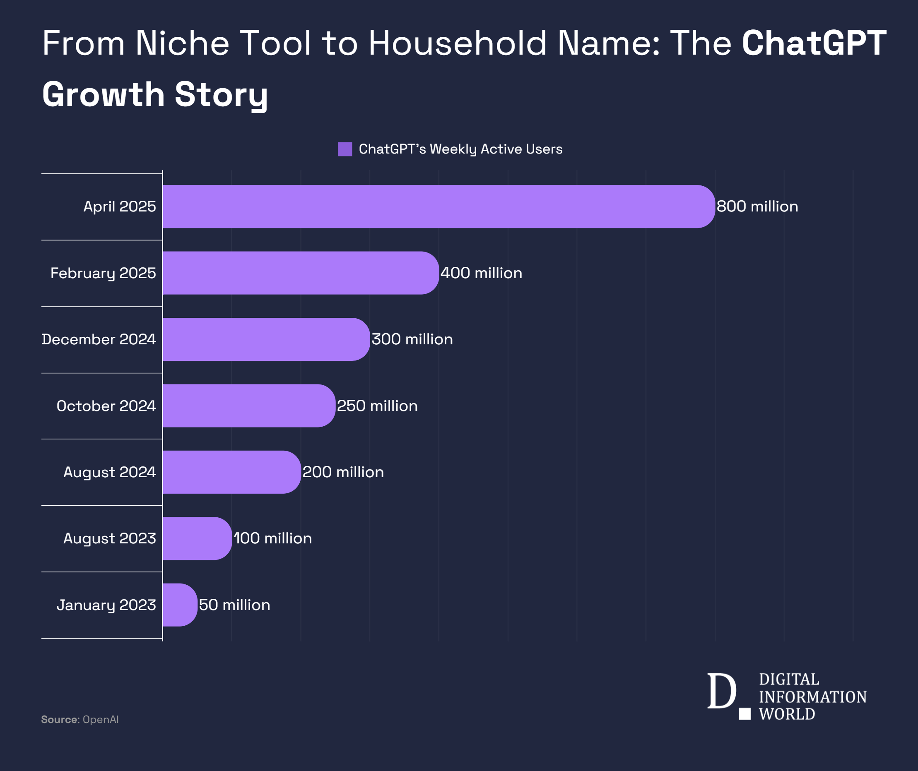
100 million

Slide 19




Slide 21


Slide 22
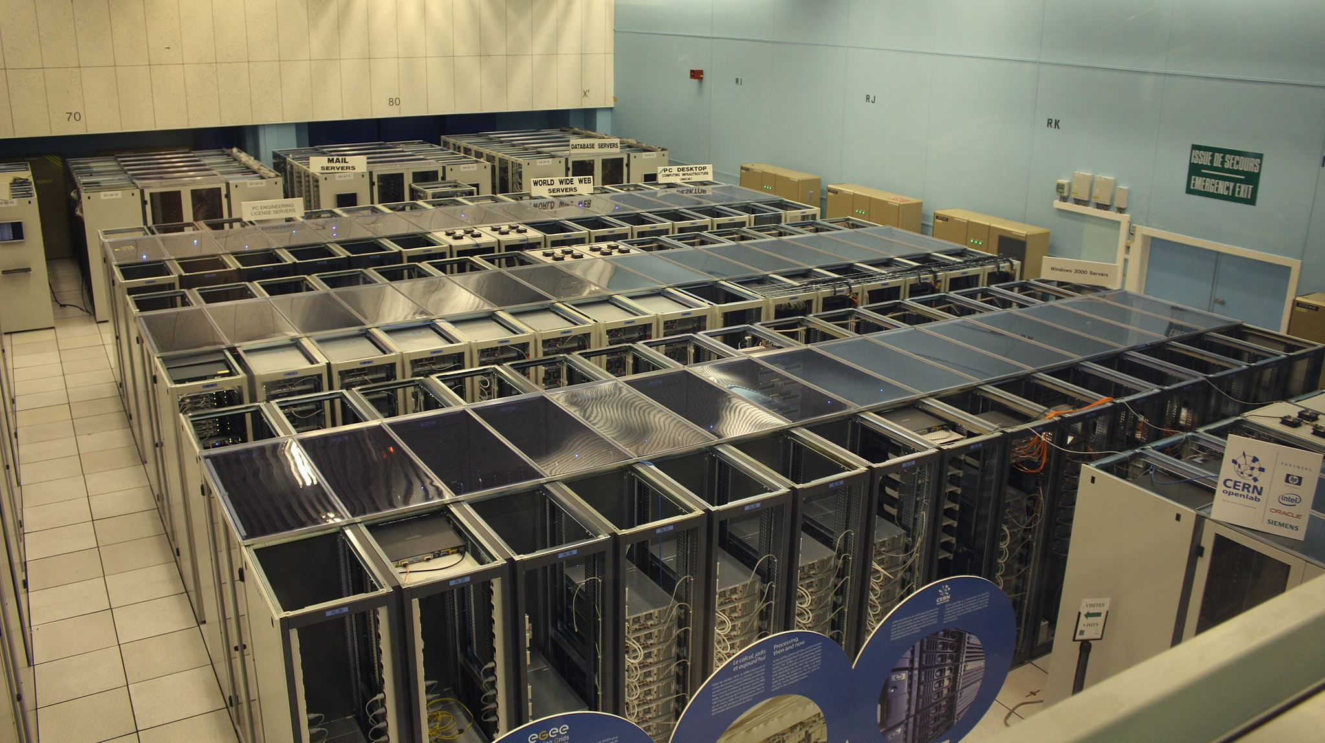

Slide 23
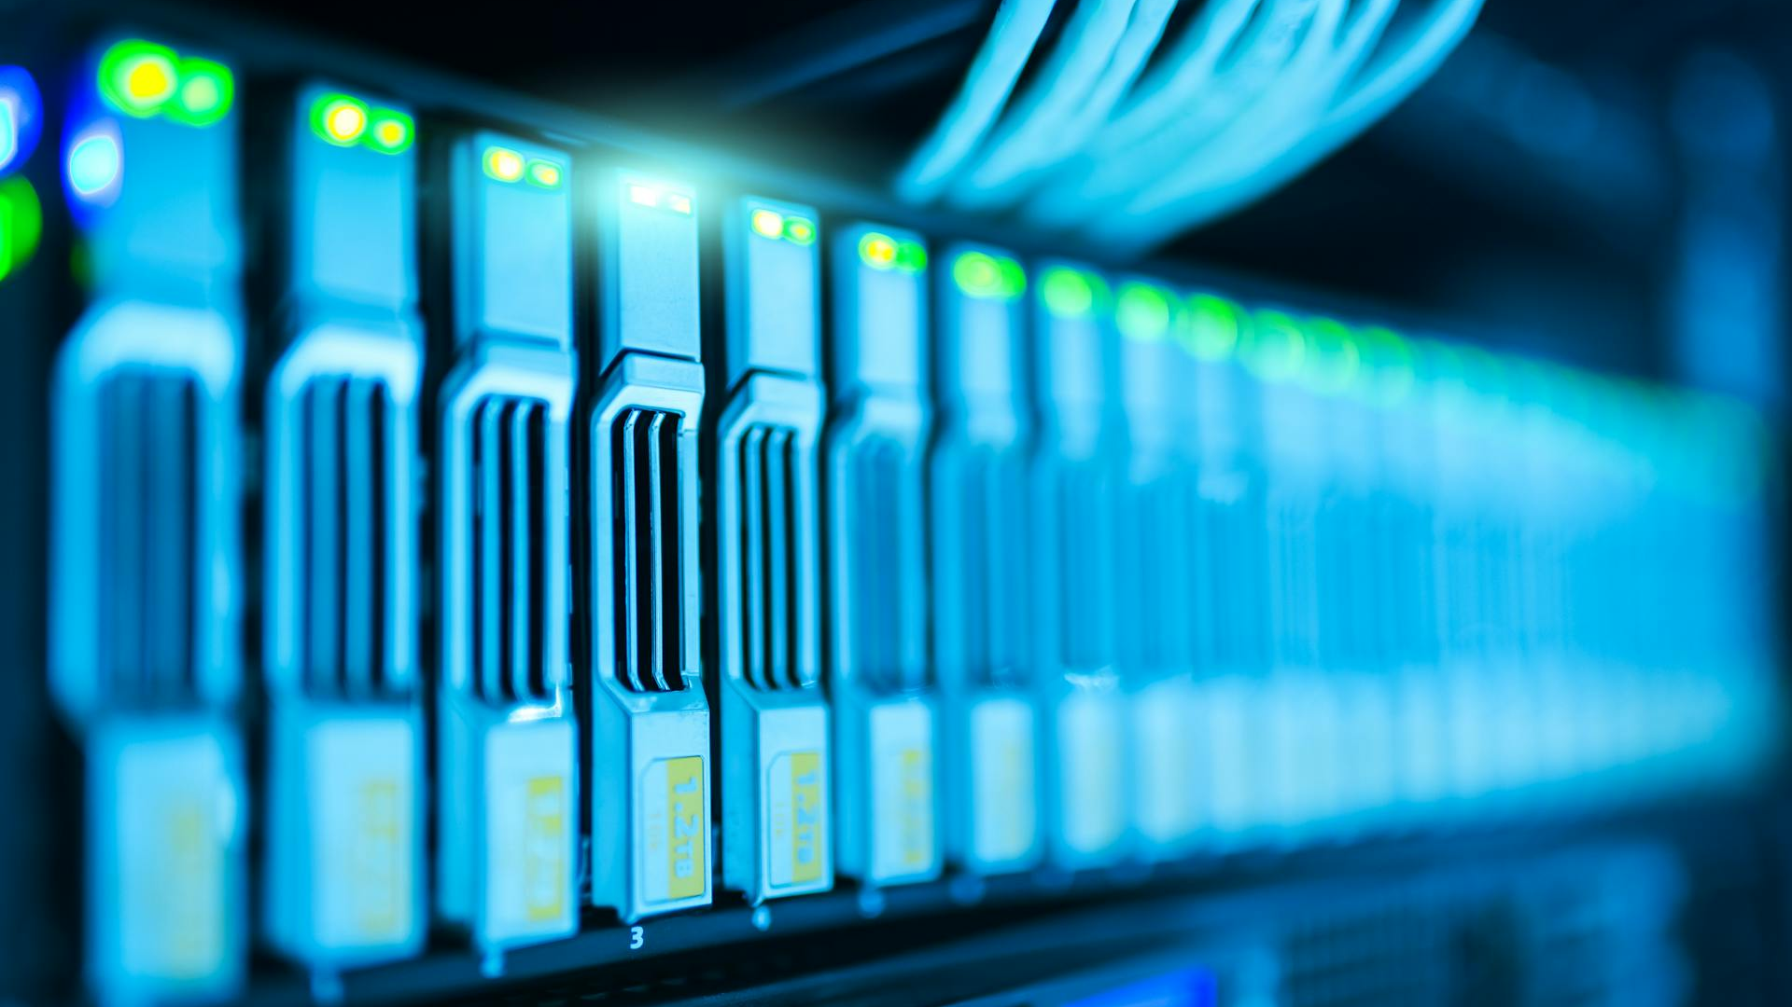

Slide 24


Slide 25
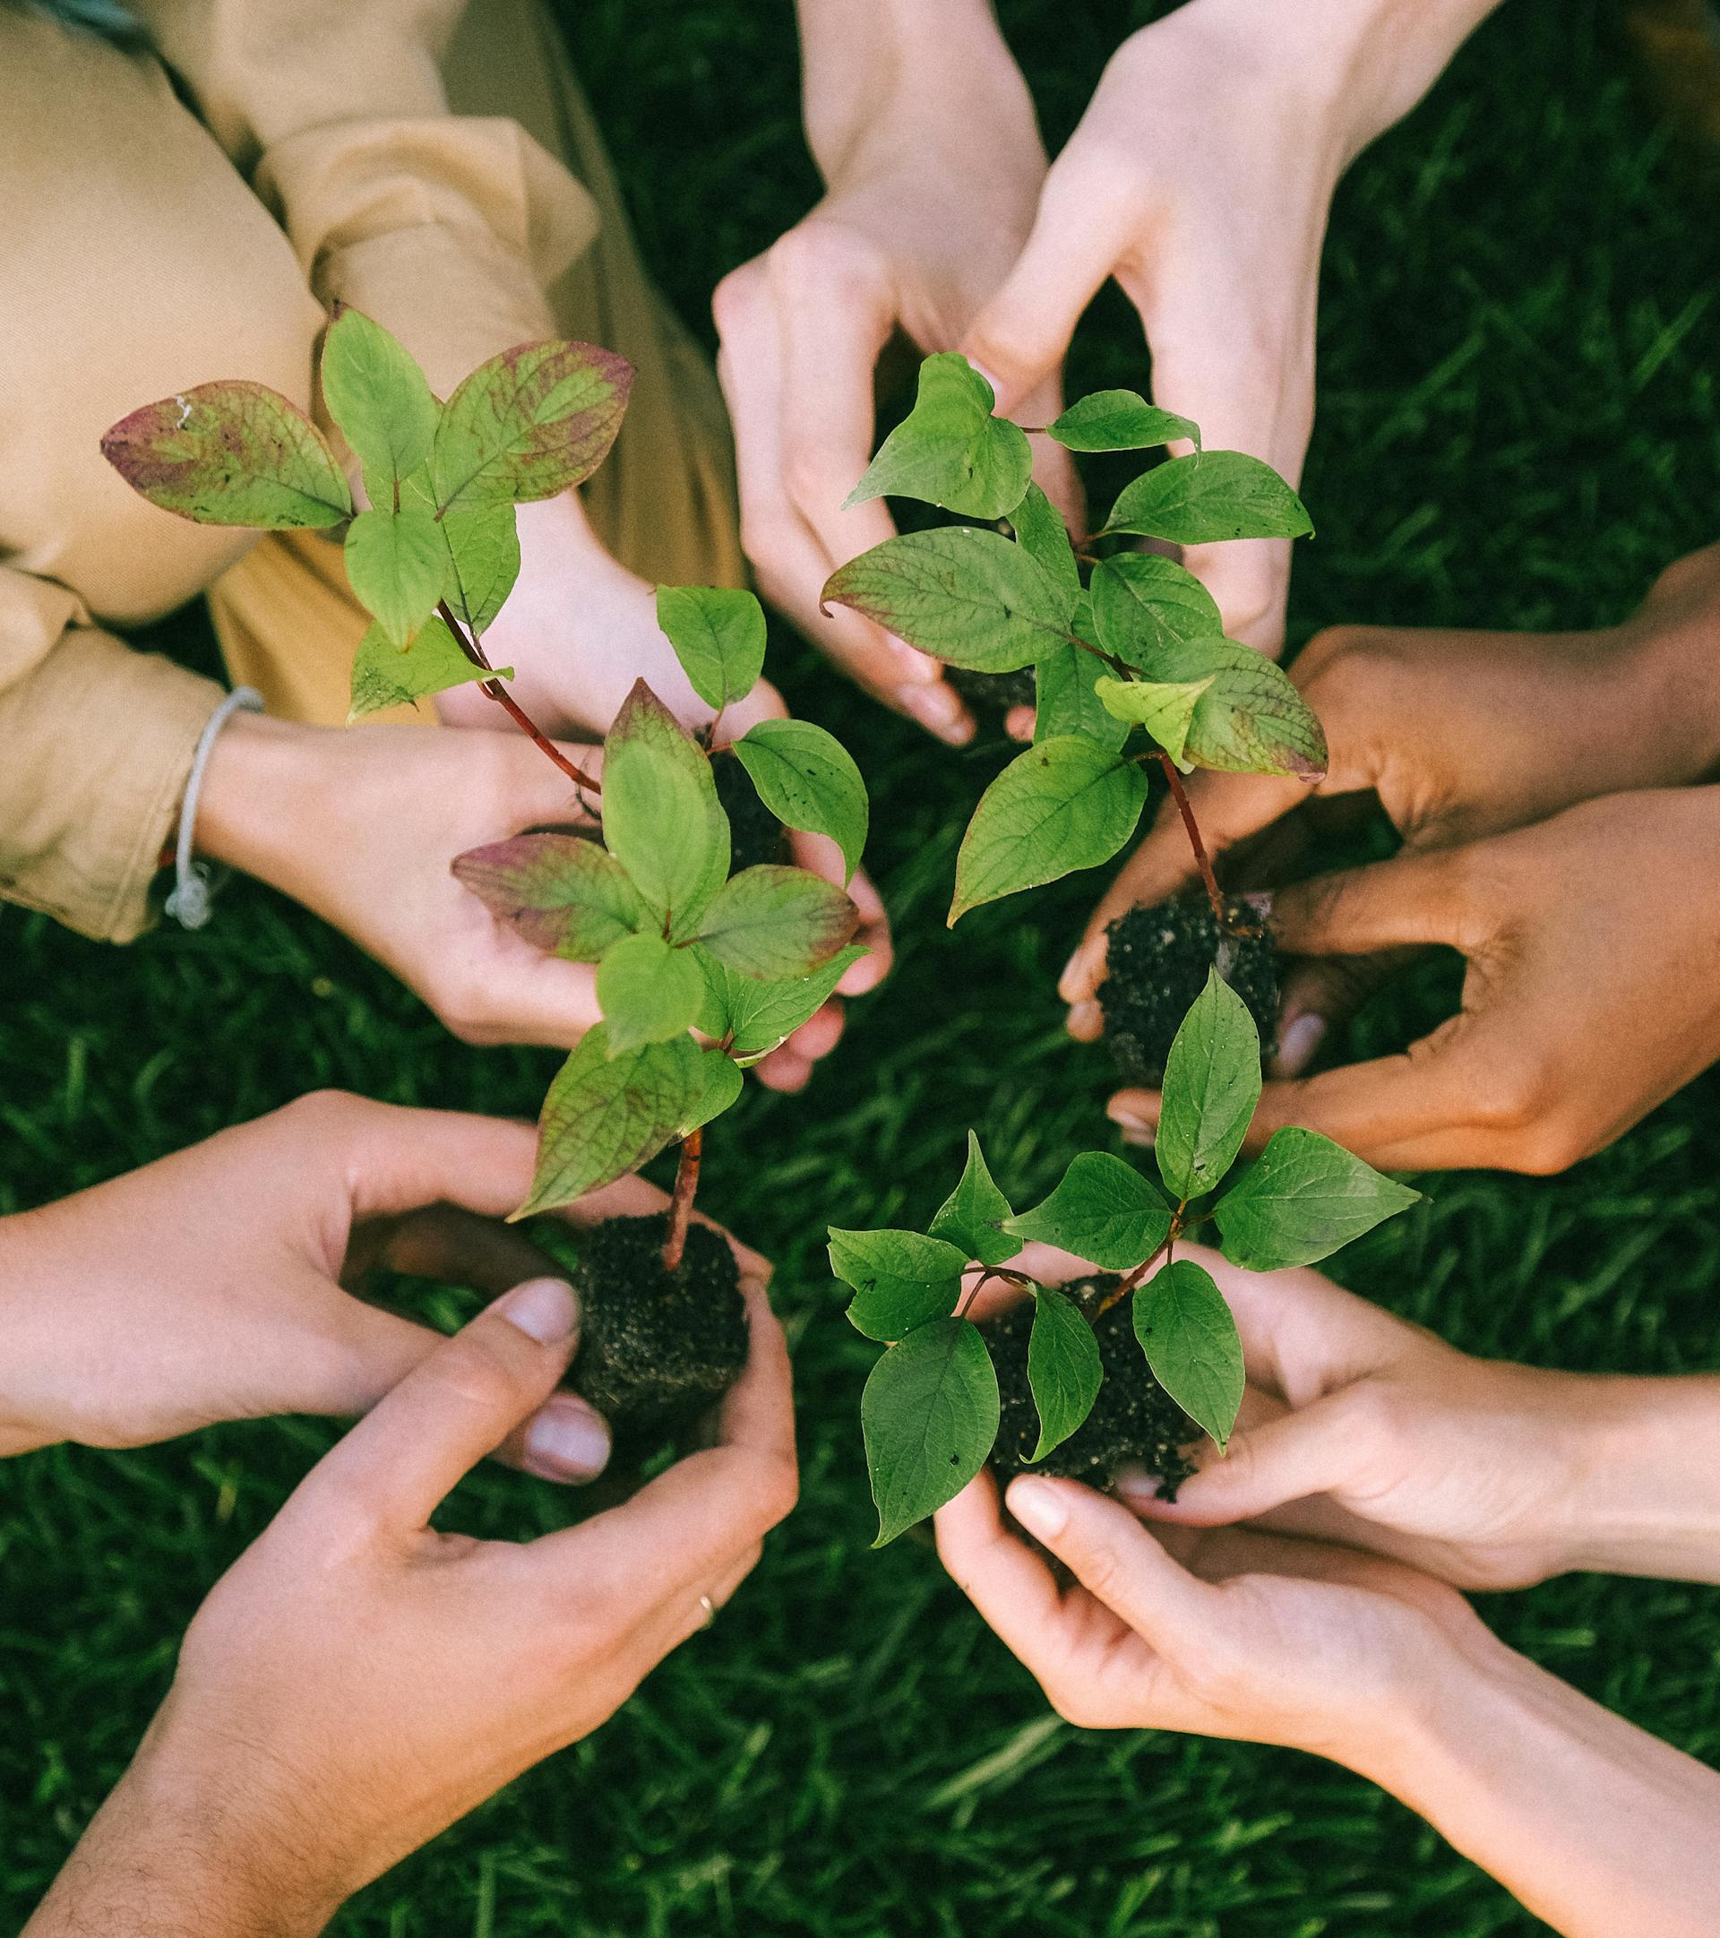


Slide 26


Slide 30
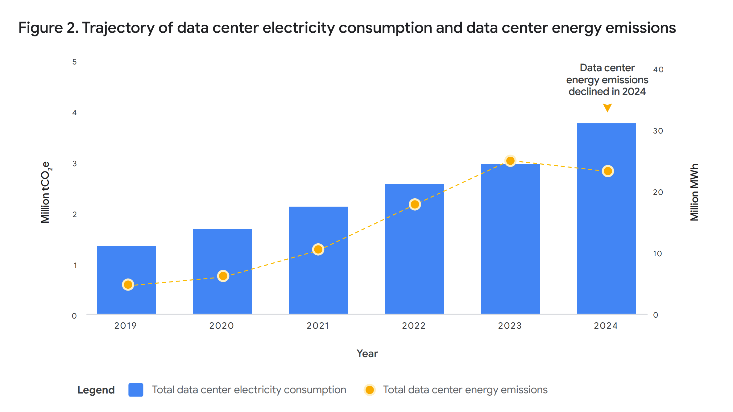

Slide 32


Slide 33
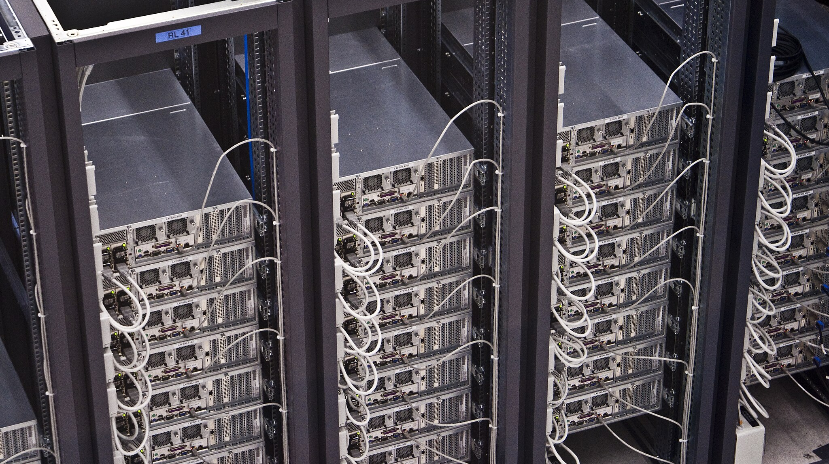

Slide 34
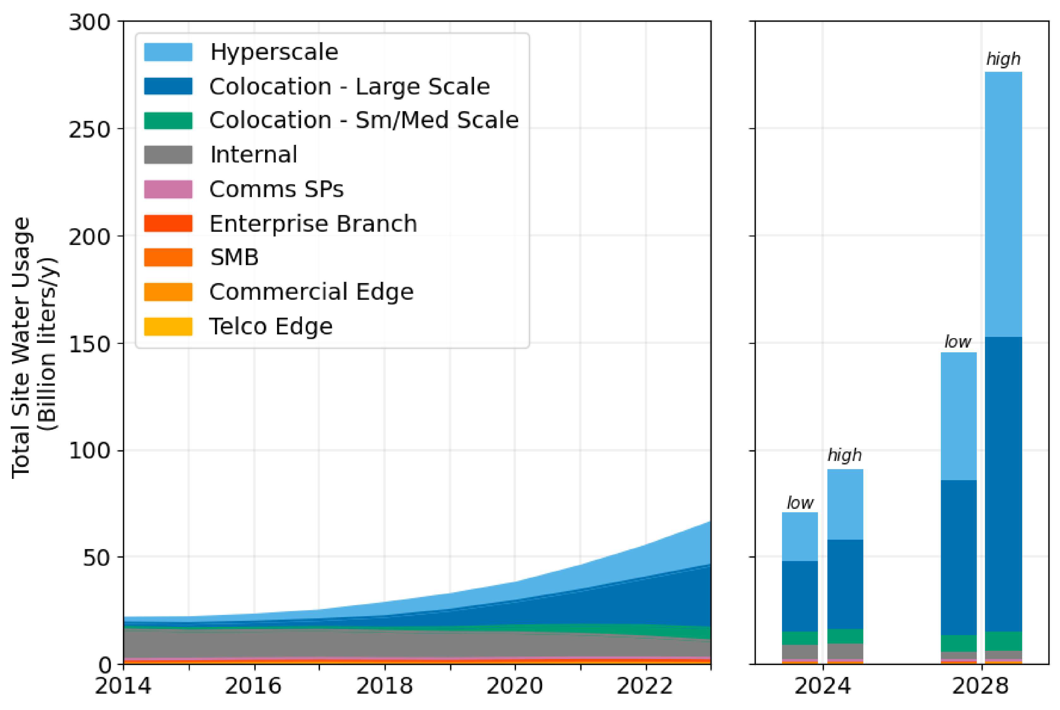

Slide 38



Slide 39
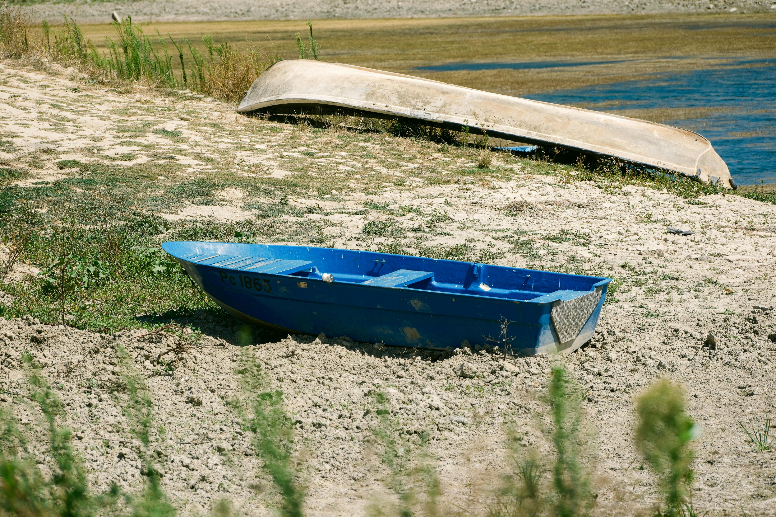

Slide 40
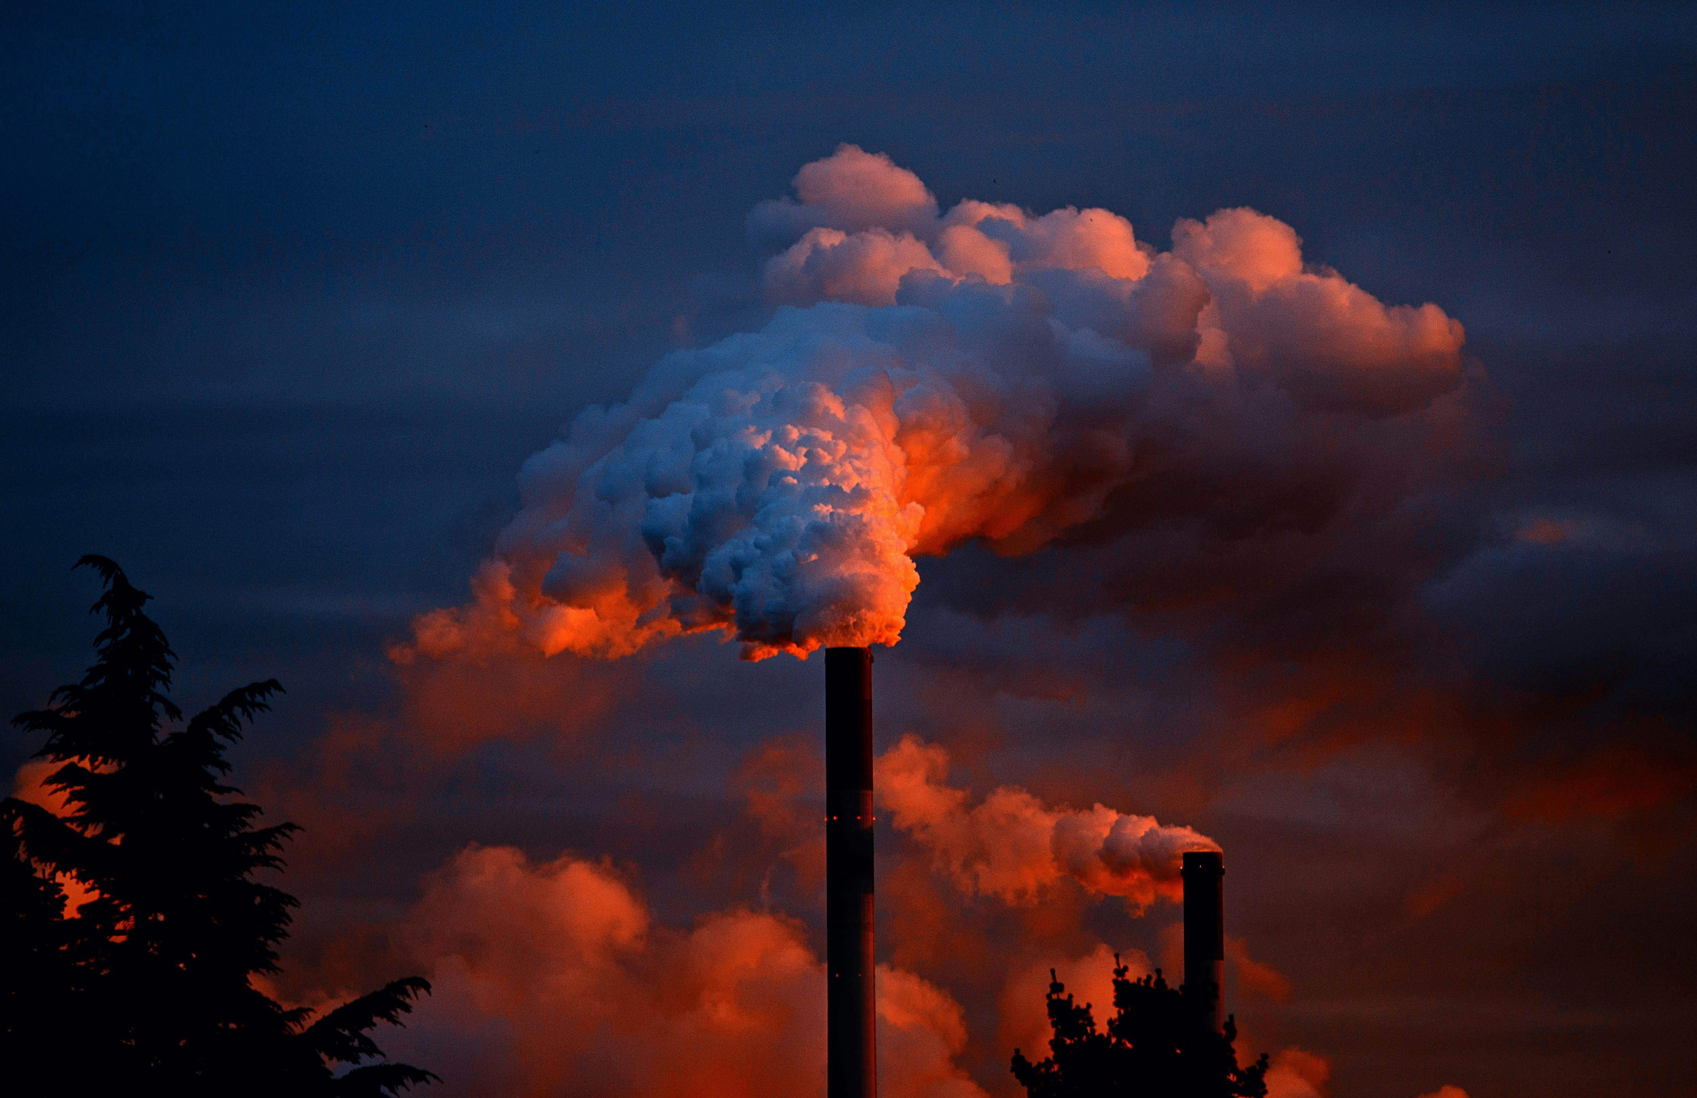

Slide 41


Slide 42


Slide 43
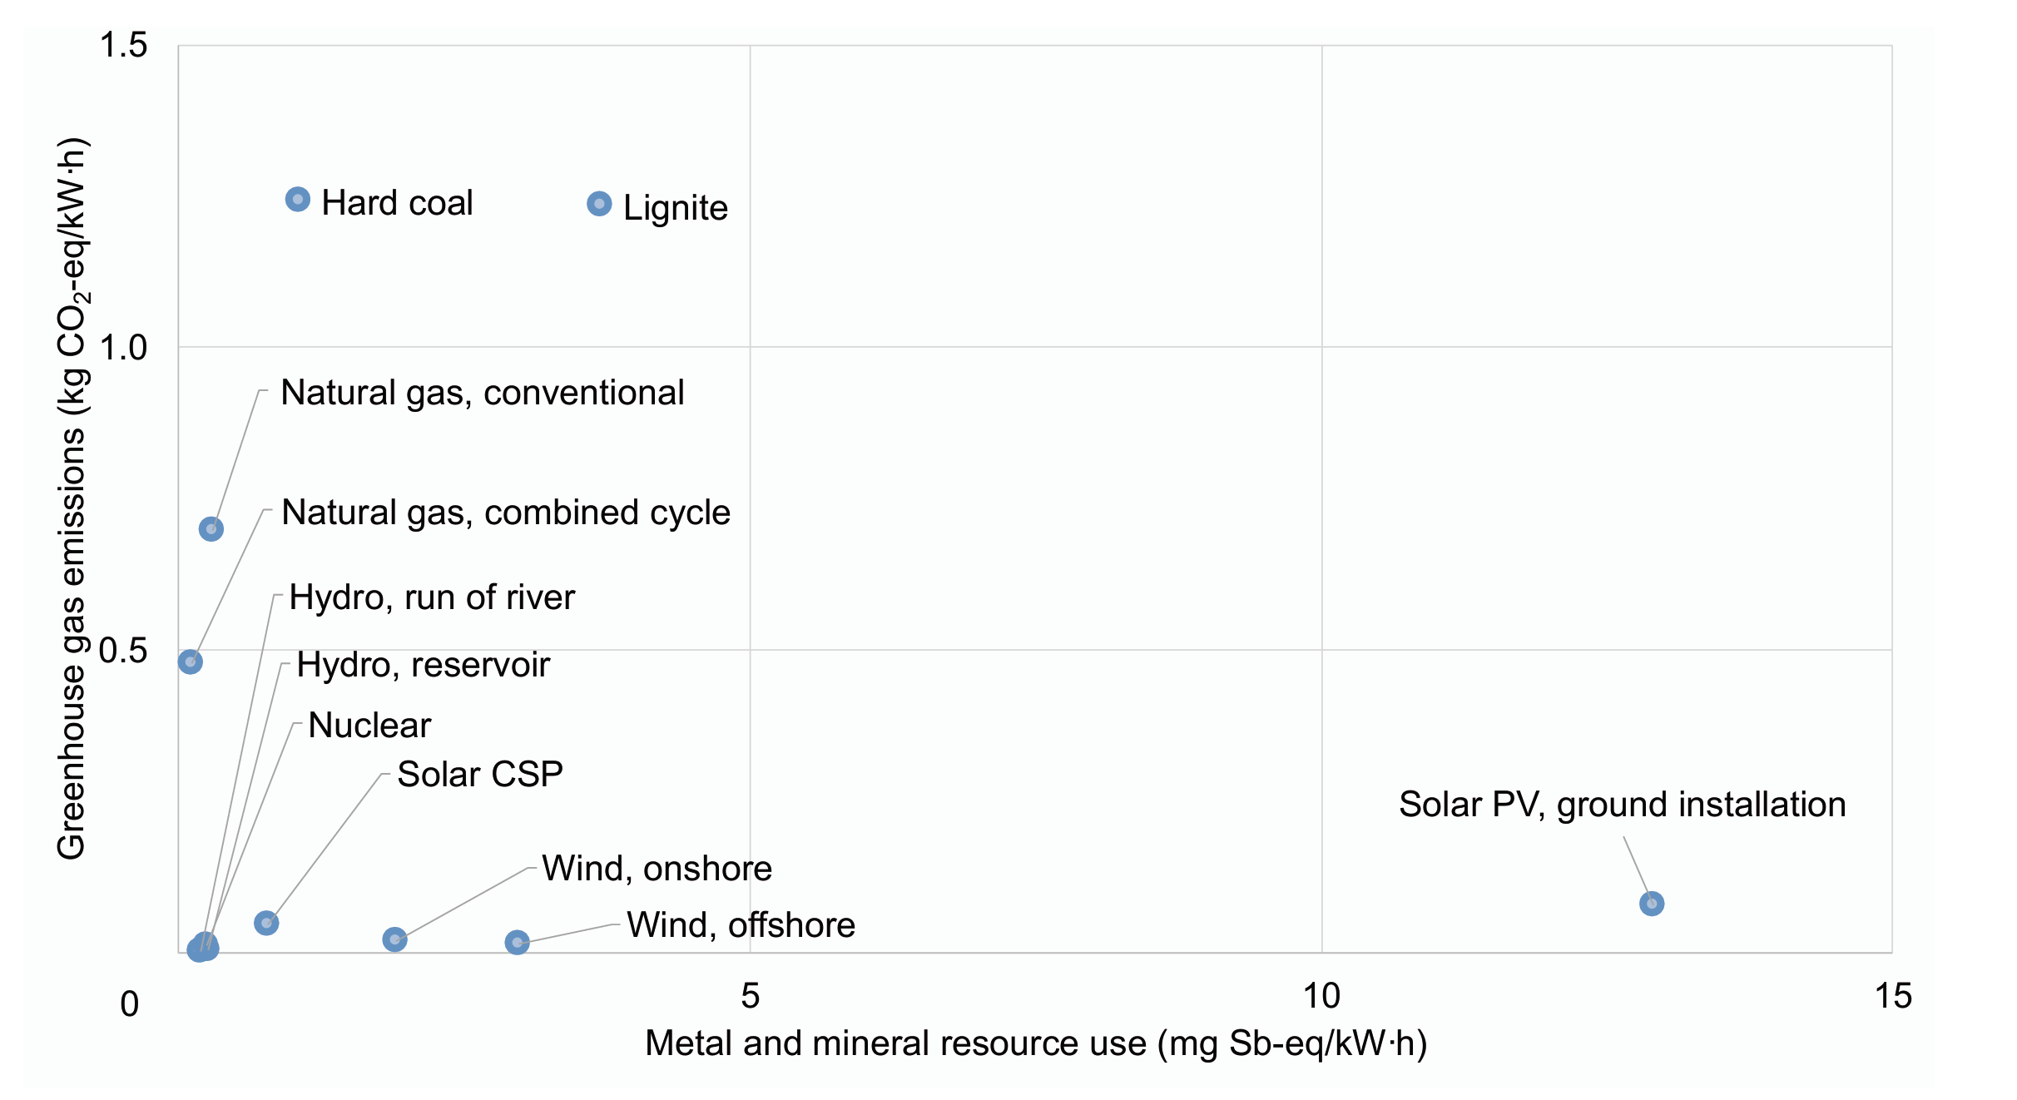

Slide 44
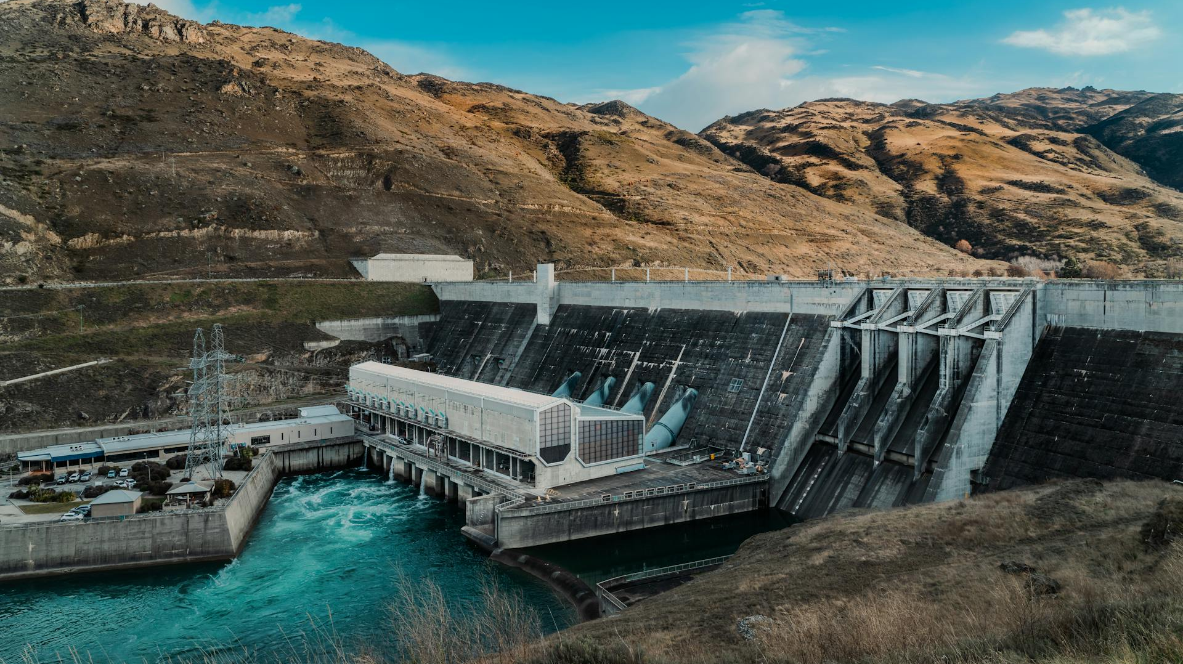

Slide 45
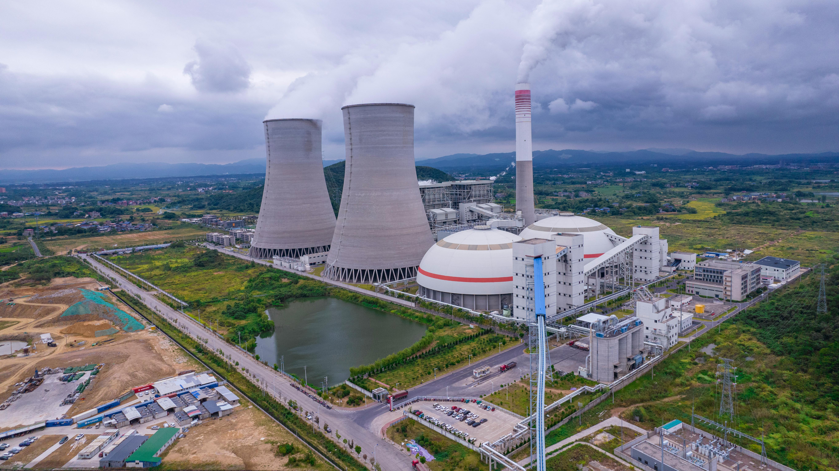

Slide 46
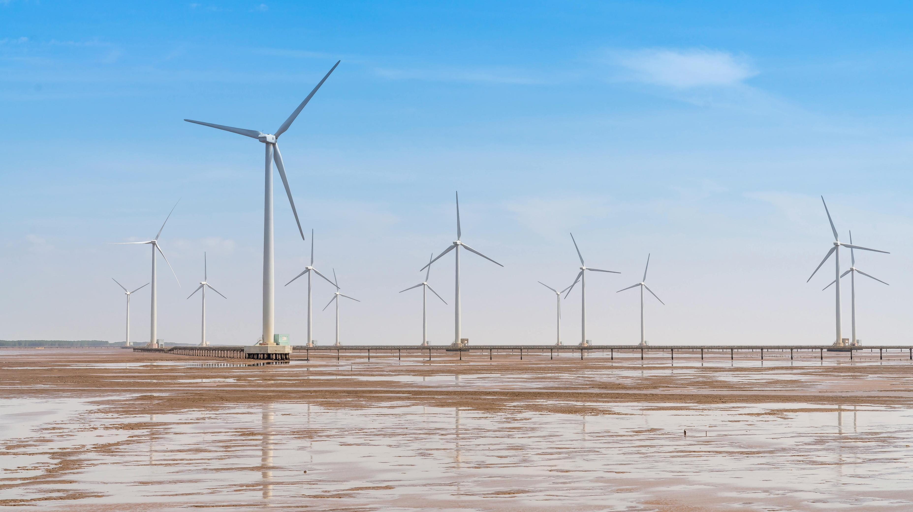

Slide 47
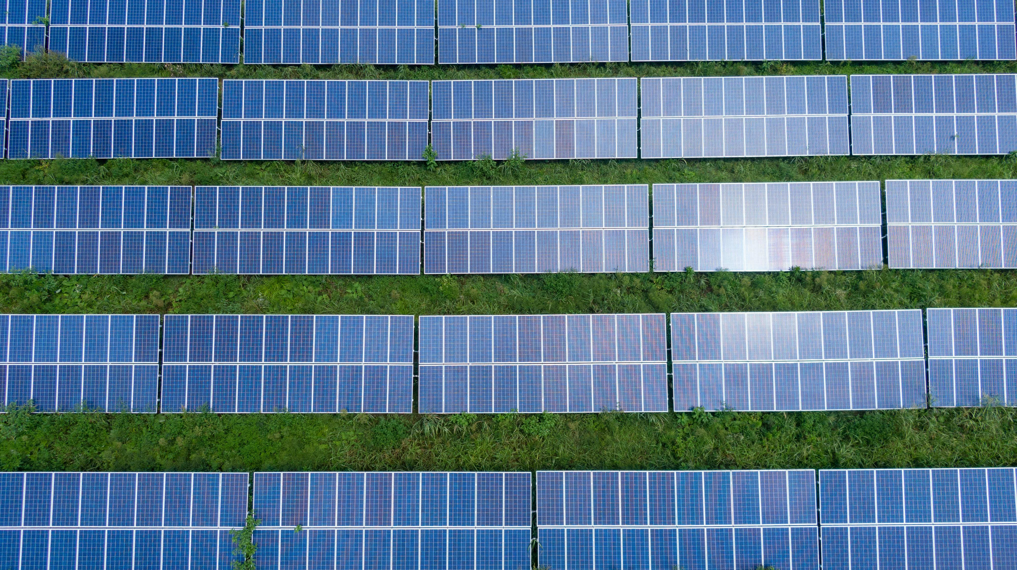

Slide 48
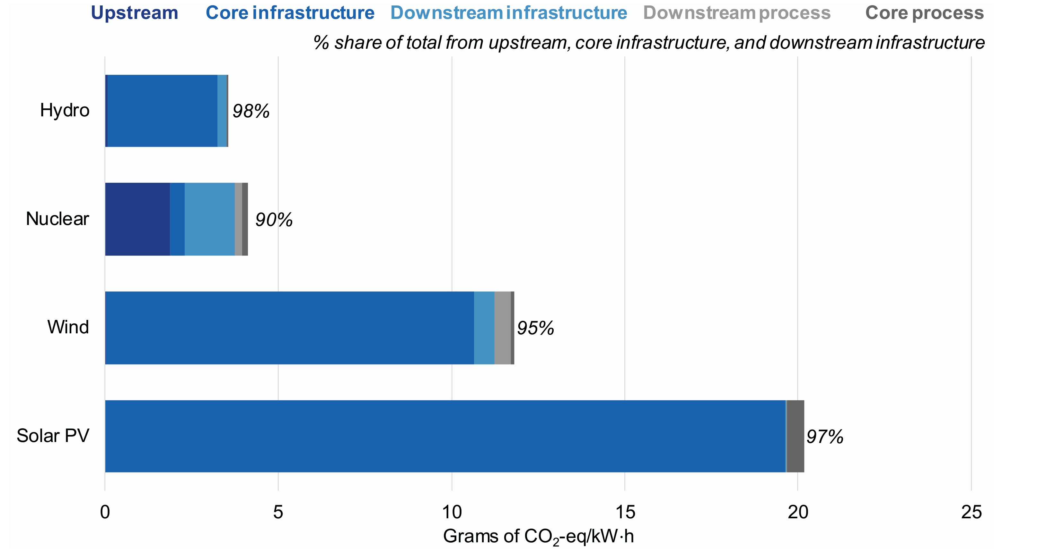

Slide 50

Closed-loop cooling systems

Slide 51
↓ 50 – 70%

Slide 52


Slide 54
What‘s on your mind today?
Ask anything

Slide 55
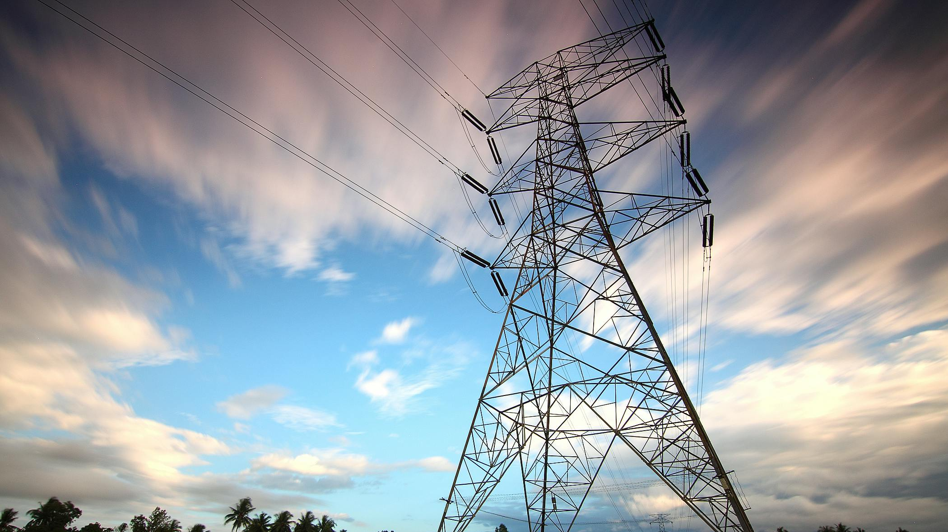

Slide 57


Slide 58


Slide 59
Information sources
https://www.digitalinformationworld.com/2025/05/chatgpt-stats-in-numbers-growth-usage-and-global-impact.html
https://sustainability.atmeta.com/wp-content/uploads/2025/10/Meta_2025-Environmental-Data-Index.pdf
https://cdn-dynmedia-1.microsoft.com/is/content/microsoftcorp/microsoft/msc/documents/presentations/CSR/2025-Microsoft-Environmental-Data-Fact-Sheet-PDF.pdf
https://www.gstatic.com/gumdrop/sustainability/google-2025-environmental-report.pdf
Shehabi, A.; Newkirk, A.; Smith, S.; Hubbard, A.; Lei, N.; Siddik, M., et al. (2024). 2024 United States Data Center Energy Usage Report. Lawrence Berkeley National Laboratory. Report #: LBNL-2001637. http://dx.doi.org/10.71468/P1WC7Q Retrieved from https://escholarship.org/uc/item/32d6m0d1
https://www.iaea.org/publications/14725/climate-change-and-nuclear-power-2020
https://www.weforum.org/stories/2024/11/circular-water-solutions-sustainable-data-centres/#:~:text=Practices%20such%20as,a%20thirsty%20world.

Slide 60
Image sources
The following slides contain images generated with the help of AI:
  1-8, 10, 12, 13, 38, 41, 50, 52, 53, 57, 58
https://www.digitalinformationworld.com/2025/05/chatgpt-stats-in-numbers-growth-usage-and-global-impact.html
  Slides: 14, 18; (slides 15-17 use the data from this website)
Meta logo - Meta Platforms, Public domain, via Wikimedia Commons
  Slides: 20, 27, 28, 31
Microsoft logo - Microsoft Corporation — Jason Wells, Public domain, via Wikimedia Commons
  Slides: 20, 27, 29, 31
Google logo - Google LLC, Public domain, via Wikimedia Commons
  Slides: 20, 27, 30, 31
Slide 21 - icon by: https://www.figma.com/community/file/1353385243808654605
Slide 22 – datacenter photo: Hugovanmeijeren, CC BY-SA 3.0 <https://creativecommons.org/licenses/by-sa/3.0>, via Wikimedia Commons
Slide 30 – Graph: https://www.gstatic.com/gumdrop/sustainability/google-2025-environmental-report.pdf
Slide 33 – photo server: Florian Hirzinger – www.fh-ap.com, CC BY-SA 3.0 <https://creativecommons.org/licenses/by-sa/3.0>, via Wikimedia Commons
Water use graph - Shehabi, A.; Newkirk, A.; Smith, S.; Hubbard, A.; Lei, N.; Siddik, M., et al. (2024). 2024 United States Data Center Energy Usage Report. Lawrence Berkeley National Laboratory. Report #: LBNL-2001637. http://dx.doi.org/10.71468/P1WC7Q Retrieved from https://escholarship.org/uc/item/32d6m0d1
  Slides: 34-37, 49
Energy sources comparison: https://www.iaea.org/publications/14725/climate-change-and-nuclear-power-2020
  Slides: 43, 49

Slide 61
Voiceover generation: https://elevenlabs.io/

